Slide 1
Bank Management System
Group Members:
Muhammad Sabtain Khan
(B22F0827AI069)
Muhammad Zain
(B22F0384AI130)
Data Structures and Algorithms

Slide 2



Introduction:
The bank management system is designed to automate various banking operations.
It serves as centralized platform for managing customers accounts and other banking activities.
Key Features:
Create ,delete and sort accounts.
Sorting based on account numbers.
File Handling(accounts.txt)
Dev C++ IDE (6.3)

Slide 3

Methodology:
Doubly Linked List:
Efficient insertion and deletion at both ends.
Bidirectional Traversal
Insertion Sort:
For small Datasets.
Less time complexity than bubble and selection sort
Arrays:
Sequential Storage.
Established a standardized format.

Slide 4

Time Complexity:
Overall time complexity is O(n) but;
createacccount() = O(1) because of constant time operations in this function.
sortaccounts() = O(n^2) in worst case.
Space Complexity:
Overall space complexity is O(n), where n is the number of customers.

Slide 5
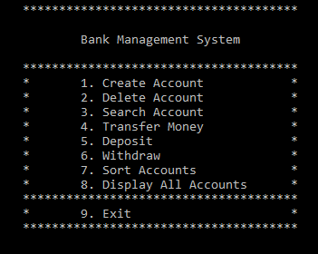
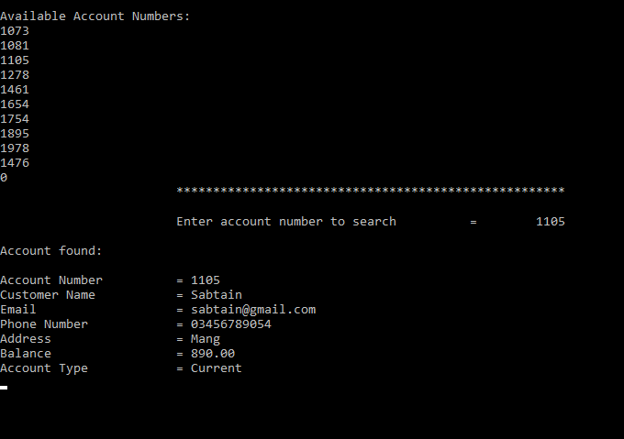
Project Output Screens:

Slide 6
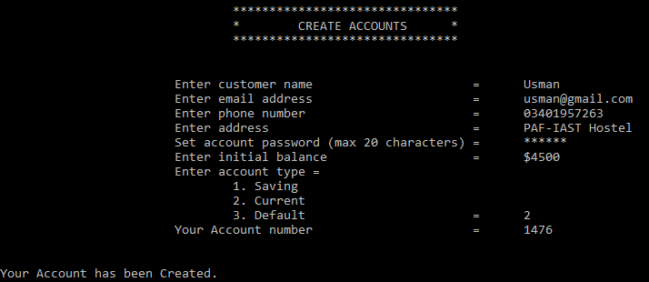
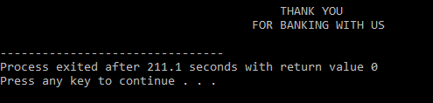
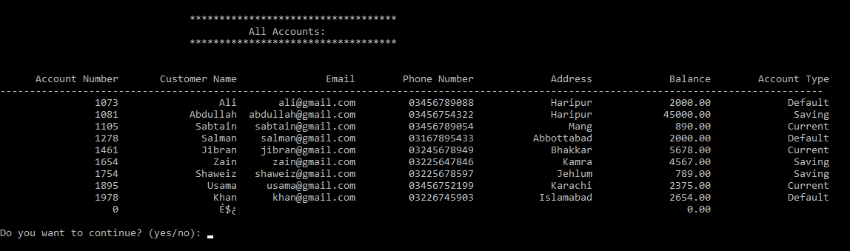

Slide 7

Thanks

